Slide 1
Design and Manufacture of an
Automatic Production Line with
Two Robotic Arms.

Slide 2

الجامعة التقنية الوسطى
الكلية التقنية الهندسية الكهربائية
قسم تقنيات السيطرة والاتمتة
علاء جاسم سليم
محمد محسن رضا
أمير رضا جاسم
م.عمران احمد شبيب/ اللجنة الخامسة
م د.عامر عطا ياسين

Slide 3
Introduction
An automatic production line with two robotic arms is a system designed to automate the manufacturing process of a product or a set of products. The system is composed of multiple machines, conveyors, sensors, and software components that work together to complete a manufacturing process without human intervention. The two robotic arms are the key components of the system, responsible for performing specific tasks such as assembling, welding, painting, or packaging.
The design of an automatic production line with two robotic arms starts with a thorough analysis of the manufacturing process that needs to be automated. The design team must identify the key components of the process, the sequence of operations, and the required cycle time. They must also consider the size, weight, and shape of the product, as well as any special handling requirements.
Automatic Production Line
Two Robotic Arms

Slide 4
Project Objectives
01
Increase the efficiency of the manufacturing process
To increase the efficiency of the manufacturing process by automating the production line and reducing the time required to manufacture products..
02
reduce labor costs
To reduce labor costs by minimizing the need for human workers and enabling the system to operate continuously without breaks.
03
Increase production capacity
To increase production capacity and throughput by enabling the system to run faster and produce more products in less time.
04
Enhance safety
To enhance workplace safety by minimizing the risk of accidents and injuries that may occur in a manual manufacturing process.

Slide 5
Project Components
IR Sensor
An IR (infrared) sensor is a device that detects infrared radiation emitted by objects and can be used to detect their presence, proximity, or motion.
TCS230 color sensor
The TCS230 color sensor is a programmable color light-to-frequency converter that can detect and measure the color of an object.
Servo Motor
A servo motor is a type of electric motor that is commonly used in robotics, automation, and other control applications where precise control of angular or linear position, velocity, or acceleration is required.
Arduino
Arduino is an open-source electronics platform based on easy-to-use hardware and software. It consists of a physical programmable circuit board (often called a microcontroller) and a software development environment used to write and upload code to the board
6DOFManipulator
A 6DOF (six degrees of freedom) manipulator is a robotic arm with six independent axes of motion, allowing it to move and rotate freely in three-dimensional space.

Slide 6
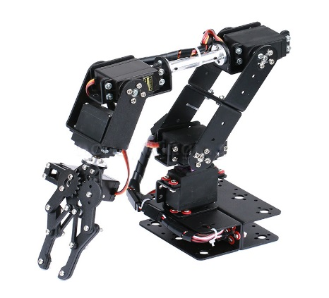
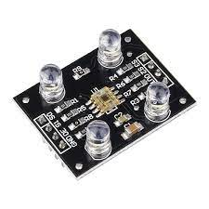
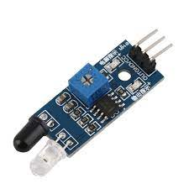
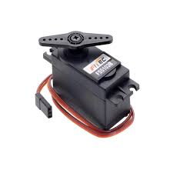
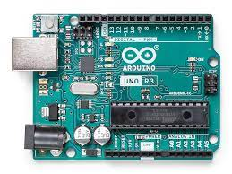
Components Style

Slide 7

challenges
Designing an efficient layout and flow of the production line
Ensuring compatibility and interoperability of different hardware and software components
Selecting and integrating the appropriate robotic arms and end-effectors
Handling and manipulating different types of products, including those with unique shapes, sizes, and weights.
Developing and programming the control system for the production line
Power and energy consumption, including designing a system that is energy-efficient and uses power effectively to minimize downtime.

Slide 8
Thank You

